Slide 1
Chapter 1
Overview of Computer Graphics
Resumes of the book
Computer Graphics using Java 2D and 3D
Computação Gráfica
Prof. Carlos Carreto
Engenharia Informática
Instituto Politécnico da Guarda

Slide 2
Objetives
Understand the goals and context of Computer Graphics.
Identify applications of Computer Graphics.
Understand the basic structure of 2D and 3D graphics systems.
Understand the evolution of graphical programming environments.
Identify common graphical APIs.
Understand the contexts of the Java language and the Java 2D and Java 3D libraries.
Identify the main sub-areas of Computer Graphics.

Slide 3
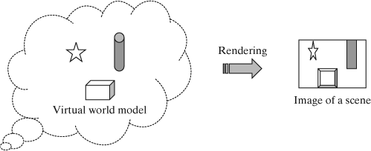
Computer Graphics
Computer Graphics is the discipline of computer science that studies the theory and techniques of modeling, processing and rendering graphic objects through computers.
Modeling: Process of building a graphic model (virtual world).
Rendering: Process of building an image (2D or 3D scene) from a graphic model.

Slide 4
Graphics System:
Components and Functions
Modeler
Renderer
Graphics devices
2D and 3D Spaces
Geometries
Geometric Transformations
Views
Lighting
Interaction
Animation

Slide 5
Graphics System:
Components and Functions
Modeler
Renderer
. . .
Shape ellipse = new Ellipse2D.Double(150, 100, 200, 200);
GradientPaint paint = new GradientPaint(100,100, Color.white,
400, 400, Color.gray);
. . .
g2.setPaint(paint);
g2.fill(ellipse);
. . .
Modeling
Rendering

Slide 6
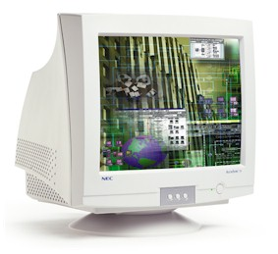
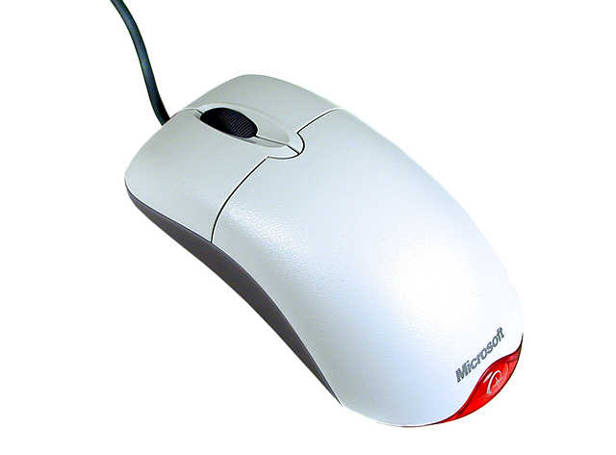
Graphics System:
Components and Functions
Graphics Devices

Slide 7
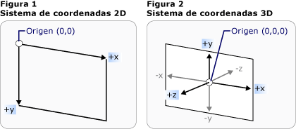
Graphics System:
Components and Functions
2D and 3D Spaces

Slide 8
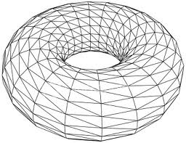
Graphics System:
Components and Functions
Geometries

Slide 9
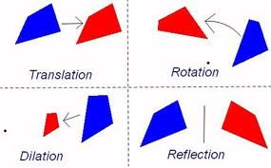
Graphics System:
Components and Functions
Geometric Transformations

Slide 10
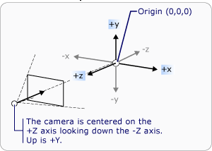
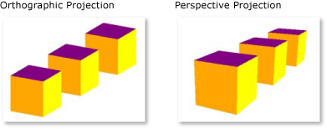
Graphics System:
Components and Functions
Views

Slide 11
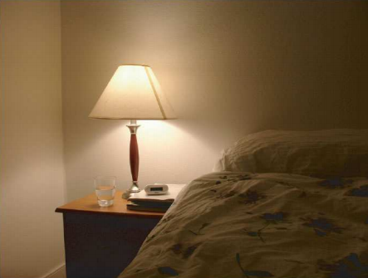
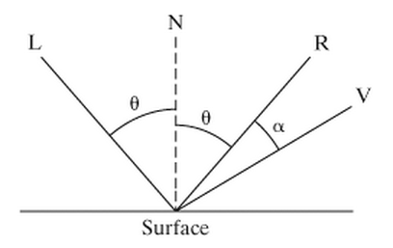
Graphics System:
Components and Functions
Lighting

Slide 12
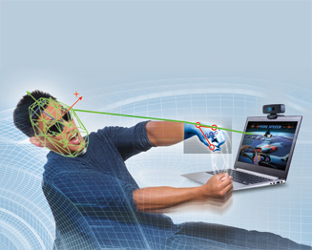
Graphics System:
Components and Functions
Interaction

Slide 13
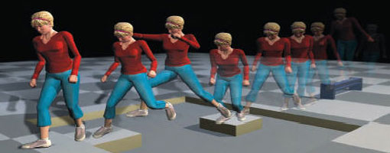
Graphics System:
Components and Functions
Animation

Slide 14
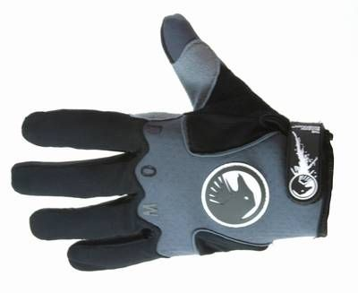
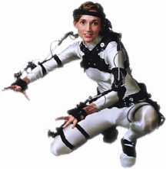
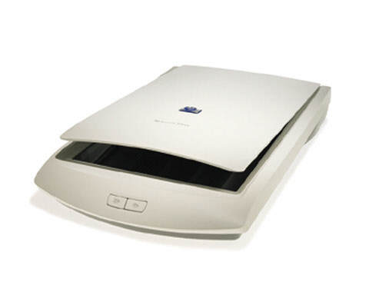
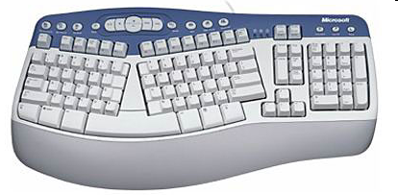
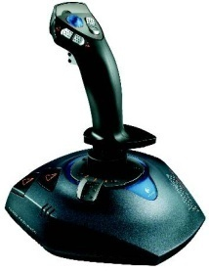
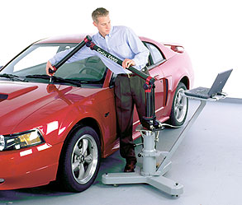
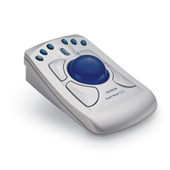

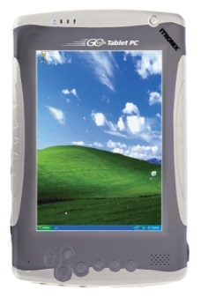
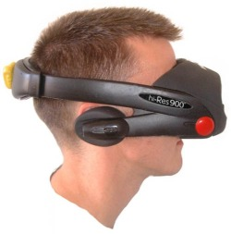
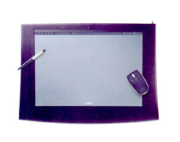
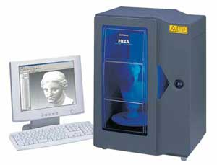
Input Graphics Devices
VR Gloves
Scanner
Keyboard
Joystick
VR Data suit
Trackball
Mouse
Three-dimensional digitizer
Tablet
Digitizer table
HMD
Three-dimensional Scanner

Slide 15
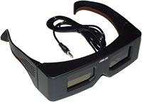
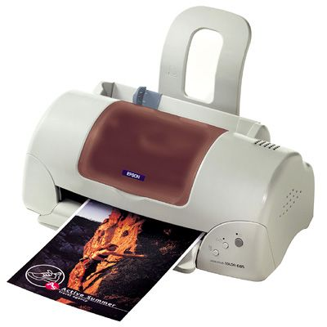
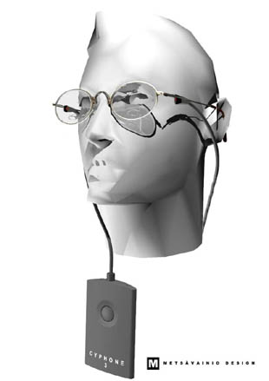
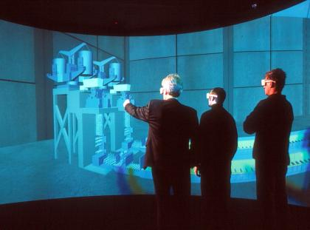
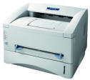

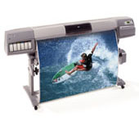

Output Graphics Devices
Stereoscopic glasses
Inkjet Printer
Monitor See-trough
Cave
LCD
Laser Printer
Plotter
Thermal printer
CRT Monitor
HMD

Slide 16
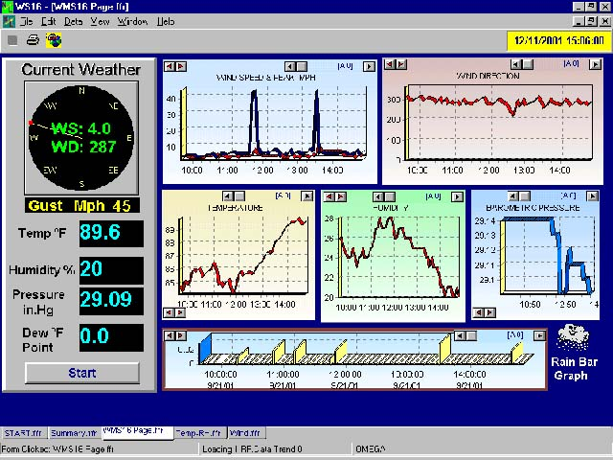
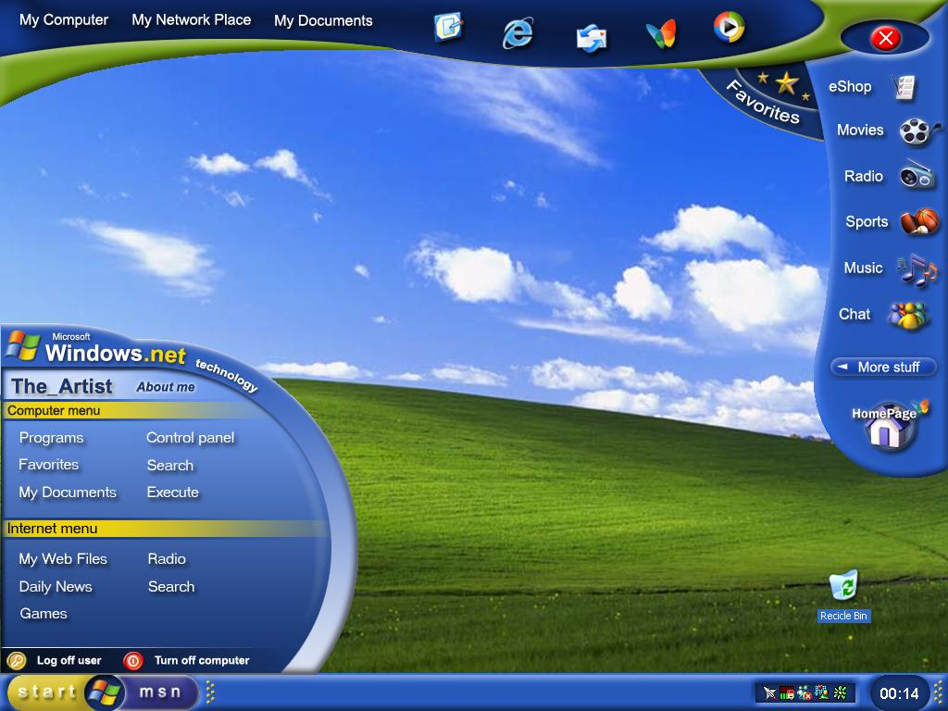
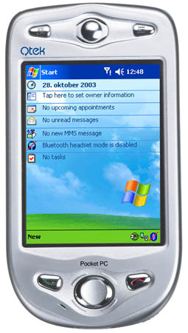
Applications
Graphical User Interface (GUI)

Slide 17
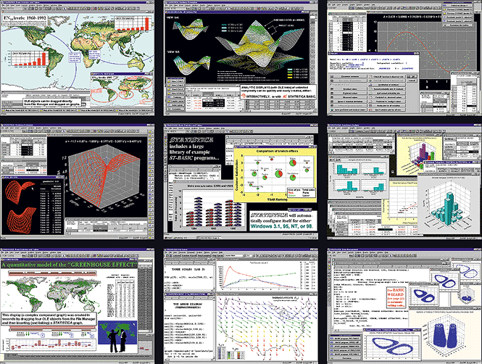
Applications
Data representation / Interactive graphic design

Slide 18
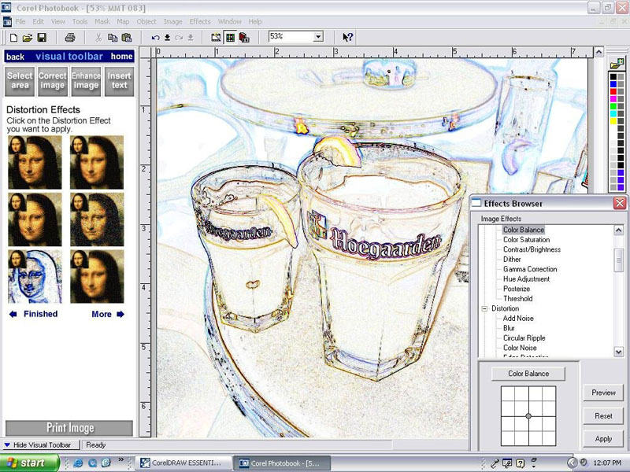
Applications
Electronic publishing

Slide 19
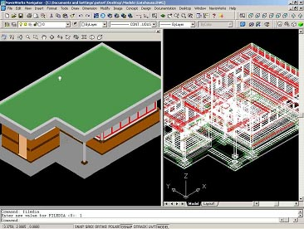
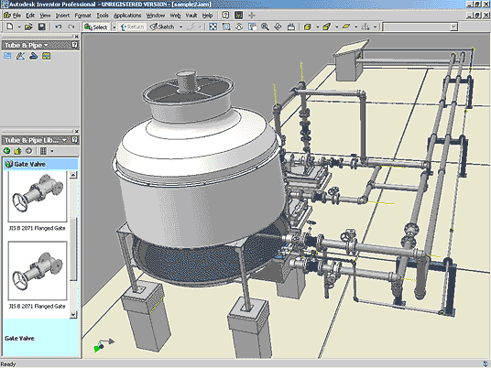
Applications
Computer Aid Design (CAD)

Slide 20
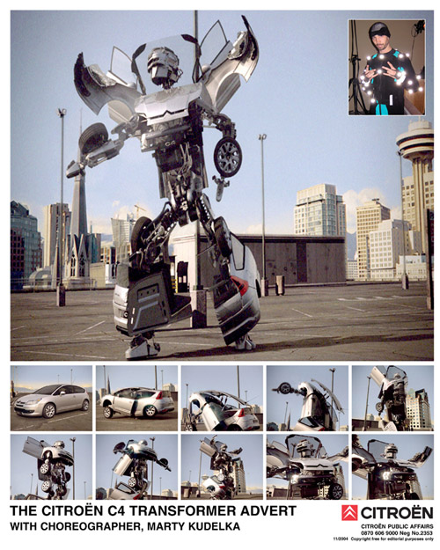
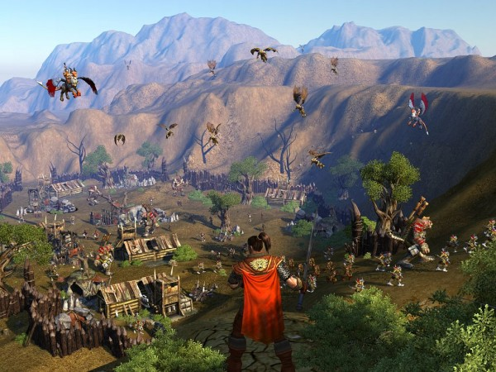
Applications
Leisure and Advertising

Slide 21
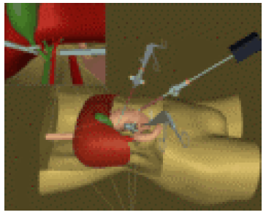
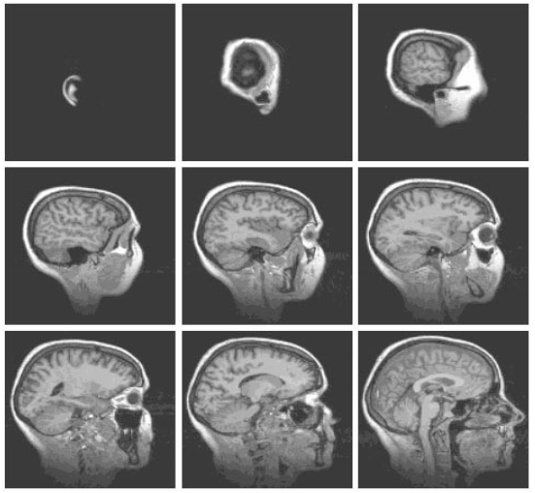
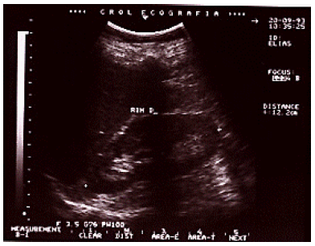
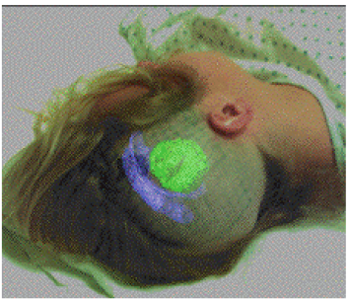
Applications
Medicine

Slide 22
Graphic Programming Environments
Examples:
Newer
Platform Independent (Ex.: Java 3D)
Graphics Standard (Ex.: GKS, PHIGS, OpenGL)
OS (Ex.: Windows, X, Mac OS)
Hardware (direct register/video buffer programming)
Older

Slide 23
Hardware Level
Direct programming of graphics hardware
Use of low level languages
Handling hardware registers and video buffers
Highly machine dependent

Slide 24
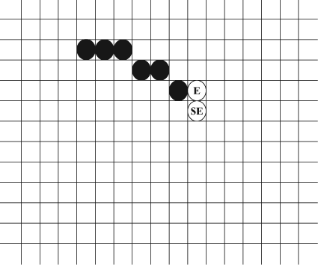
Hardware Level
Example: MS-DOS Assembly Programming to Draw a Circle
Fonte
Rendering a circle consists of determining the pixels to activate.
In the example on the right, a possible algorithm should choose between the east pixel and the southwest pixel of the last activated pixel.

Slide 25

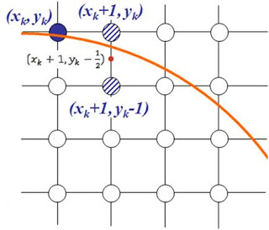
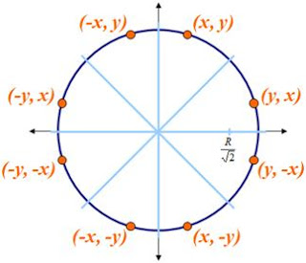
Example of an Algorithm for Drawing Circles (Midpoint Algorithm)
http://www.asksatyam.com/2011/01/midpoint-circle-algorithm.html

Slide 26
Operating System Level
Programming through graphical operating system support
No direct hardware manipulation
Device Independence
Portable within same platform

Slide 27
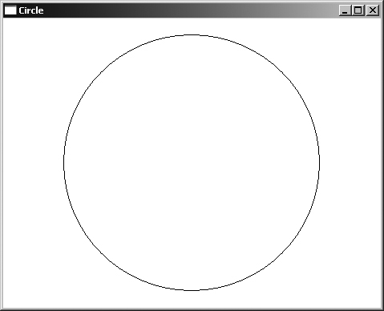
Operating System Level
Example: WIN32 Program to Draw a Circle
Source
Run

Slide 28
GKS and PHIGS
Graphics Kernel System (GKS)
International Standard (ISO 7942 1985)
2D graphics
Platform Independence
Language binding: FORTRAN
Programmer’s Hierarchical Interactive Graphics System
ISO 9592 1991
3D graphics

Slide 29
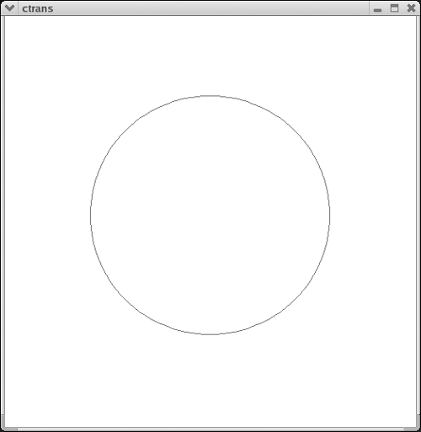
GKS and PHIGS
Example: FORTRAN GKS Program to Draw a Circle
Source

Slide 30
OpenGL
Popular API for 2D and 3D Graphics
Industry Standard
Hundreds of functions
C writing (procedure oriented)
Platform independent
Present in major operating systems
Main libraries:
GLUT
GLU
GL

Slide 31
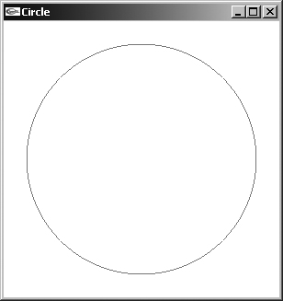
OpenGL
2D Example: OpenGL Program for Drawing a Circle
Source
Run

Slide 32
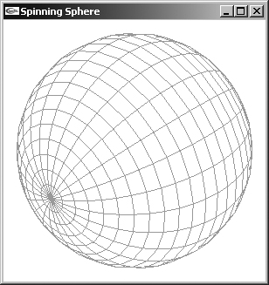
OpenGL
3D Example: OpenGL Program to Draw a Rotating Sphere
Source
Run

Slide 33
Java
Java-based graphics systems architecture
Graphics application
Java APIs
Java 3D
Java VM
OpenGL
OS
Display driver
Graphics card
Display

Slide 34
Java Programming Language
Simple
Object Oriented (OOP)
Wide range of COUNTRY
Platform independent
Multitasking
Graphic Programming with AWT or Swing
Source
Example with AWT (Abstract Windowing Toolkit)
Run

Slide 35
JOGL
API for using OpenGL in Java
Not object oriented
Create GLCanvas or GLJPanel object through the GLDrawableFactory class.
Add a GLEvent listener to the canvas object.
Implement the listener by implementing 4 methods: init, display, reshape, and displayChanged.
Source
Run

Slide 36
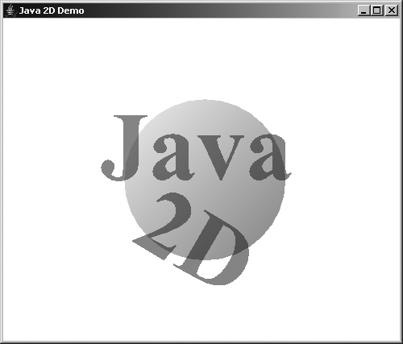
Java 2D
Java 2 Platform Standard Package
Major improvements over AWT API (Graphics class)
New Graphics2D Class
Demo: <DIRECTORY_INSTALLATION_JAVA> \ demo \ jfc \ Java2D
Fonte
Run

Slide 37


Java 3D
High level API with huge graphics capabilities
Use a scene graph to model the virtual world
Paradigm Modeling-Rendering
Source
Run

Slide 38
Major Subareas
Computer Graphics is currently divided into four major subareas that are sufficiently differentiated and deserve their own definitions:
Image Synthesis
Image Processing
Image Analysis
Computational Visualization

Slide 39

Major Subareas
Image Synthesis
Image Synthesis is the artificial generation of images from a set of definitions. The goal is the creation and representation of objects and scenes from their mathematical descriptions. Examples of applications are CAD systems, simulation, animation, games, special effects in cinema, etc.

Slide 40


Major Subareas
Image Processing
Image Processing consists of transforming images in order to change their visual characteristics in order to improve their perception or to prepare them for further analysis. This is the case of the treatment of satellite images, the improvement of photographs, etc.

Slide 41

Major Subareas
Image Analysis
Image Analysis is the analysis of digital images for information extraction. Such as the recognition and classification of patterns contained in images, optical address recognition systems, medical diagnosis from tissue images, robotic vision, etc.

Slide 42

Major Subareas
Computational Visualization
Computer Visualization is the graphical representation of information, in order to facilitate the understanding of numerical data sets of great complexity. Examples of application areas are medical imaging, meteorology, stock market financial data, fluid dynamics studies, and many others. The graphical representation is automatically generated from the data and it is up to the user to define image parameters and attributes to better navigate the data set. In this way, data visualization shares characteristics of synthesis, processing and image analysis.
http://www.youtube.com/watch?v=GyfL7Cm6YDM

Slide 43
Mathematical Bases of Computer Graphics
Analytical Geometry
Complex Numbers and Quaternions
Linear algebra
Geometric Transformations
Mathematical Analysis (Calculus)
Graph Theory
See Appendix A of the book "Appendix A. Mathematical Background for Computer Graphics"

